Slide 1

IMDB Movie Subtitles
Text Analysis &
Clustering by Sentiment Vectors
Team Eazy E Scarlett, Yolanda, Echo, Nate, Joaquin

Slide 2

Outline
Intro & Data collection
Exploratory Analysis
1) Topic modeling
2) Network Analysis
3. Sentiment Analysis
4. Clustering & Regression based on sentiment
5. Conclusion

Slide 3
Intro & Data collection
Exploratory Analysis
1) Topic modeling
2) Network Analysis
3. Sentiment Analysis
4. Clustering & Regression based on sentiment
5. Conclusion

Slide 4
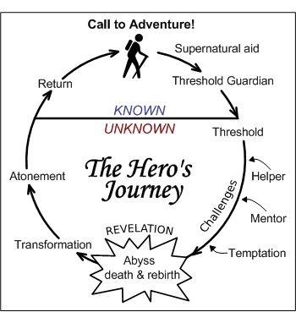
Emotional Trajectory vs. Plot
1. Introduction

Slide 5


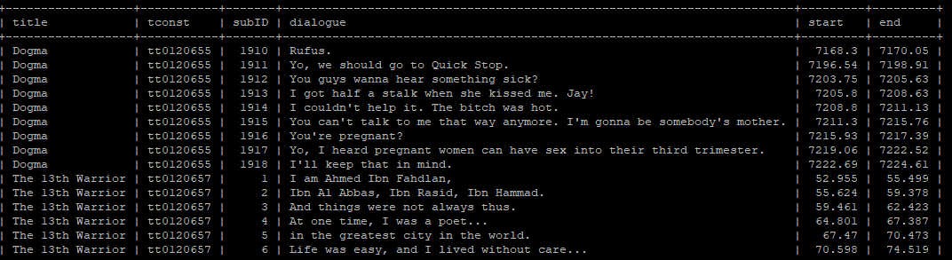
Data Collection
1. Introduction
Around 1,800 Scripts
Films since 1998
Excluded documentaries and shorts
Most films classified as multiple genres

Slide 6
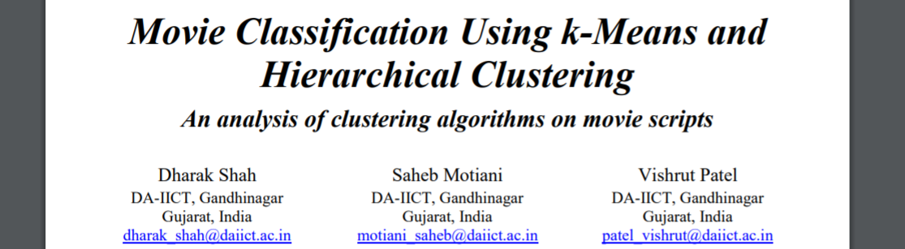
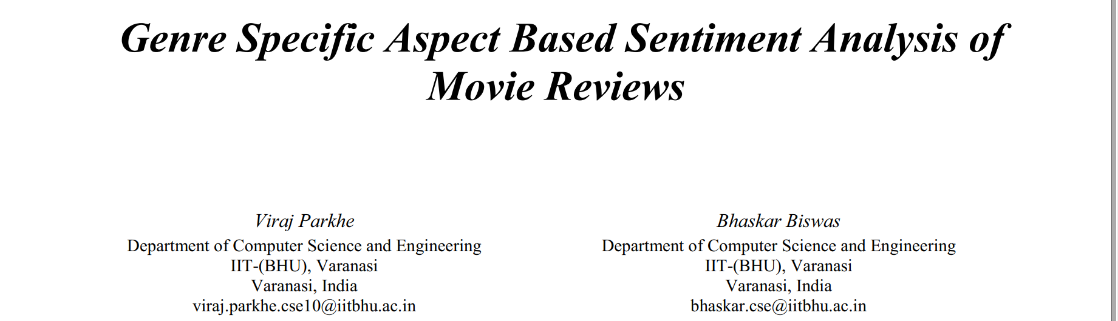
1. Introduction
Prior research

Slide 7
Intro & Data collection
Exploratory Analysis
1) Topic modeling
2) Network Analysis
3. Sentiment Analysis
4. Clustering & Regression based on sentiment
5. Conclusion

Slide 8
Raw Data
2. Exploratory Analysis - Topic modeling(1/11)
WORD | N
you | 567154
the | 433149
i | 388814
to | 319557
a | 293322
and | 195472
it | 190128
of | 161233
that | 157002
me | 145762
1861 movies
17 genres
14352971 words
126,877 different words
Clean Data
1213 movies
17 genres
1092796 words
28302 different words
Remove Stop Words (built in and personalized)
Removed movies > 500 lines of dialogue.
Removed movies that did not fit in the pre-defined clusters
WORD | N
love | 19867
call | 14448
talk | 14404
fuck | 14323
wait | 11861
peopl | 10661
stop | 10231
feel | 9883
life | 9586
girl | 9548

Slide 9
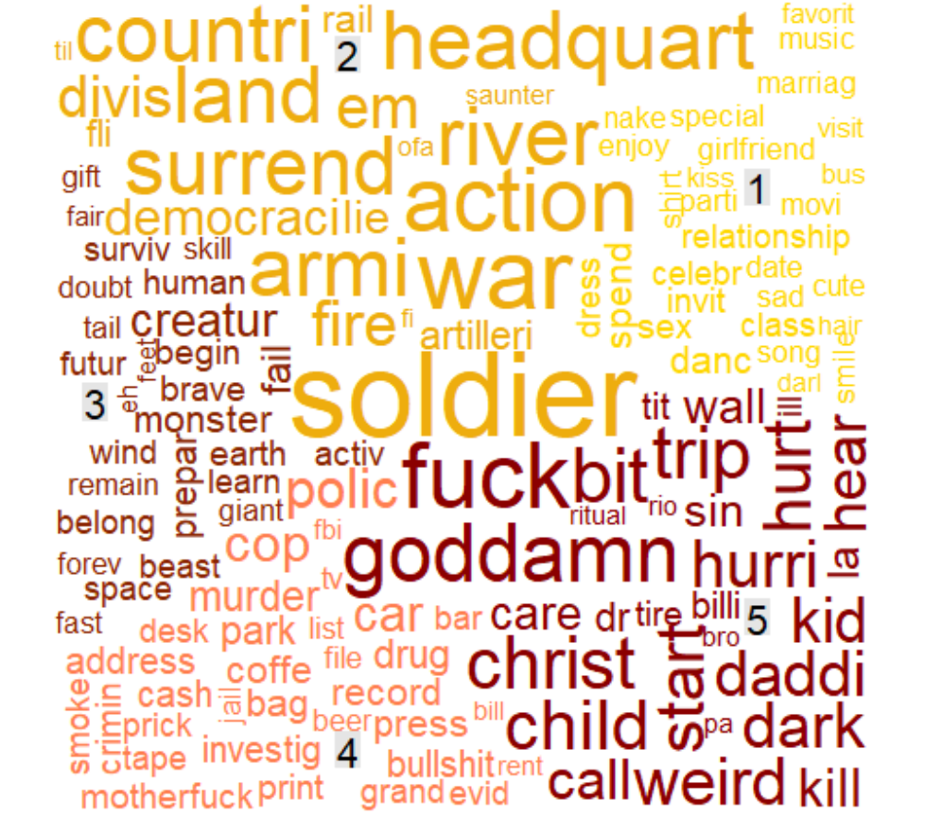
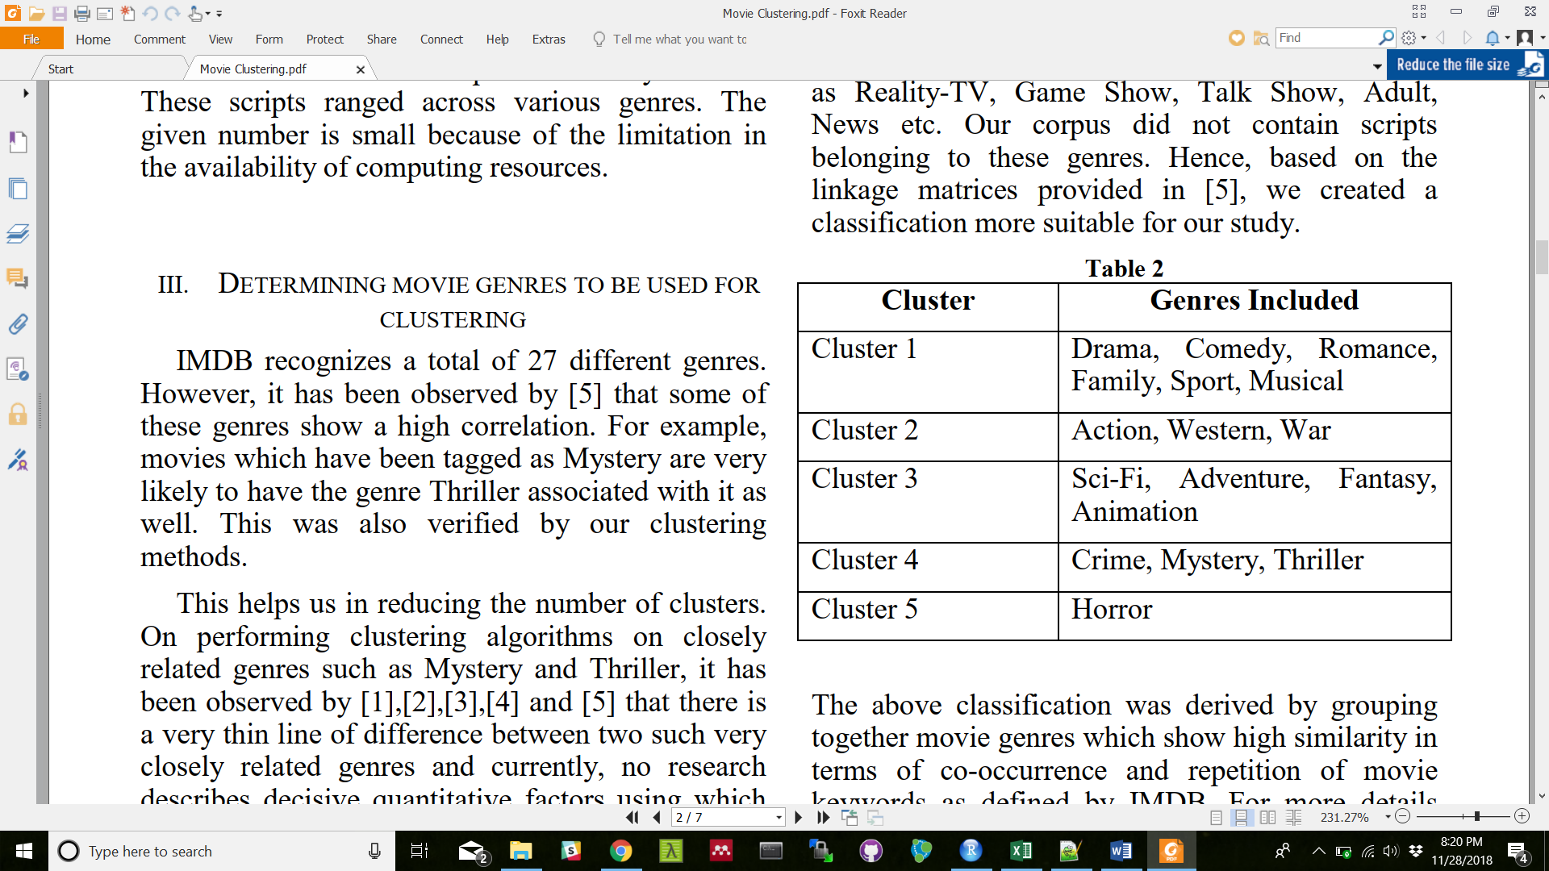
Word Cloud for Movies in 5 Distinct Genres
2. Exploratory Analysis(11\11)
clusters of referred Paper

Slide 10
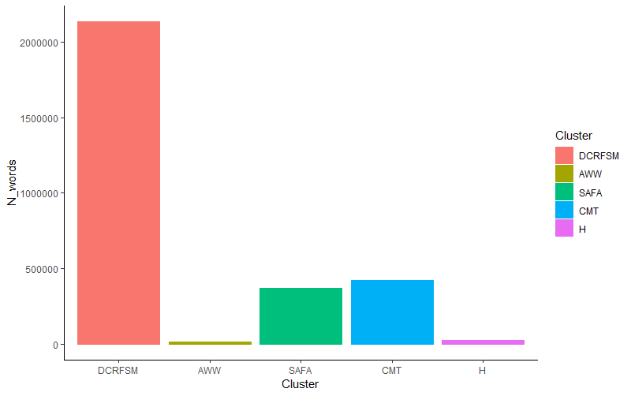
CLUSTER N movies
Drama (DCRFSM) 845
Action (AWW) 8
Animation (SAFA) 175
Crime (CMT) 203
Horror (H) 17
NA 613
3. Exploratory Analysis - Topic modeling(4\11)

Slide 11
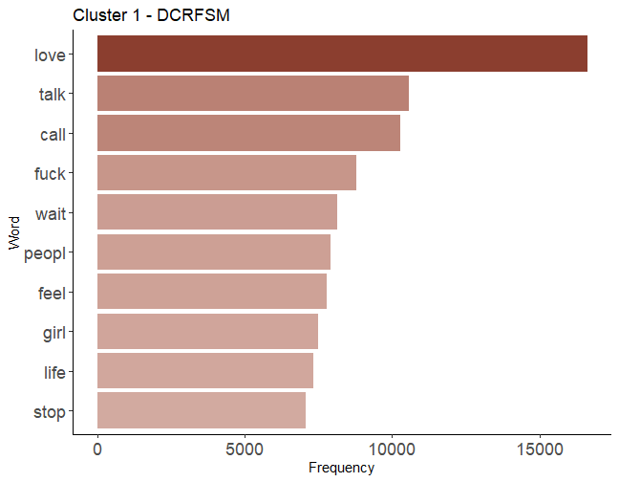
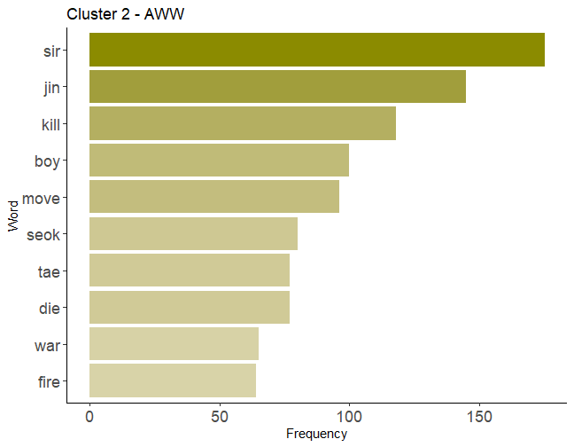
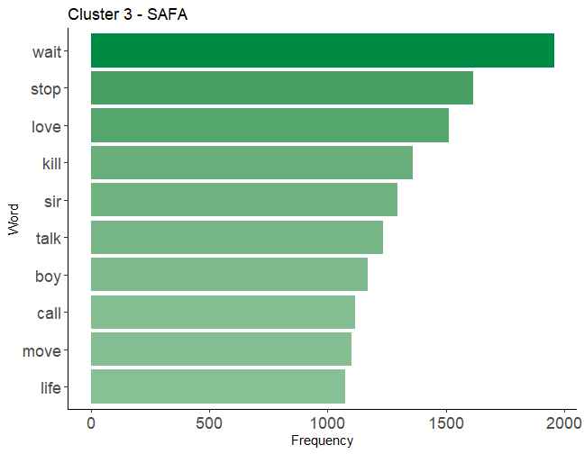
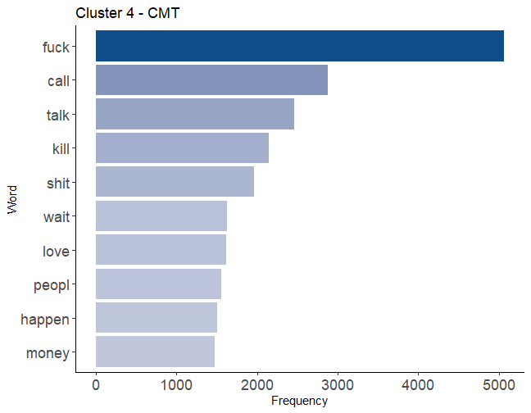
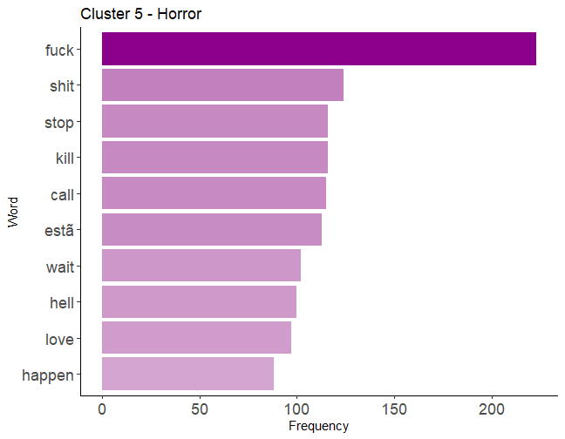

Slide 12
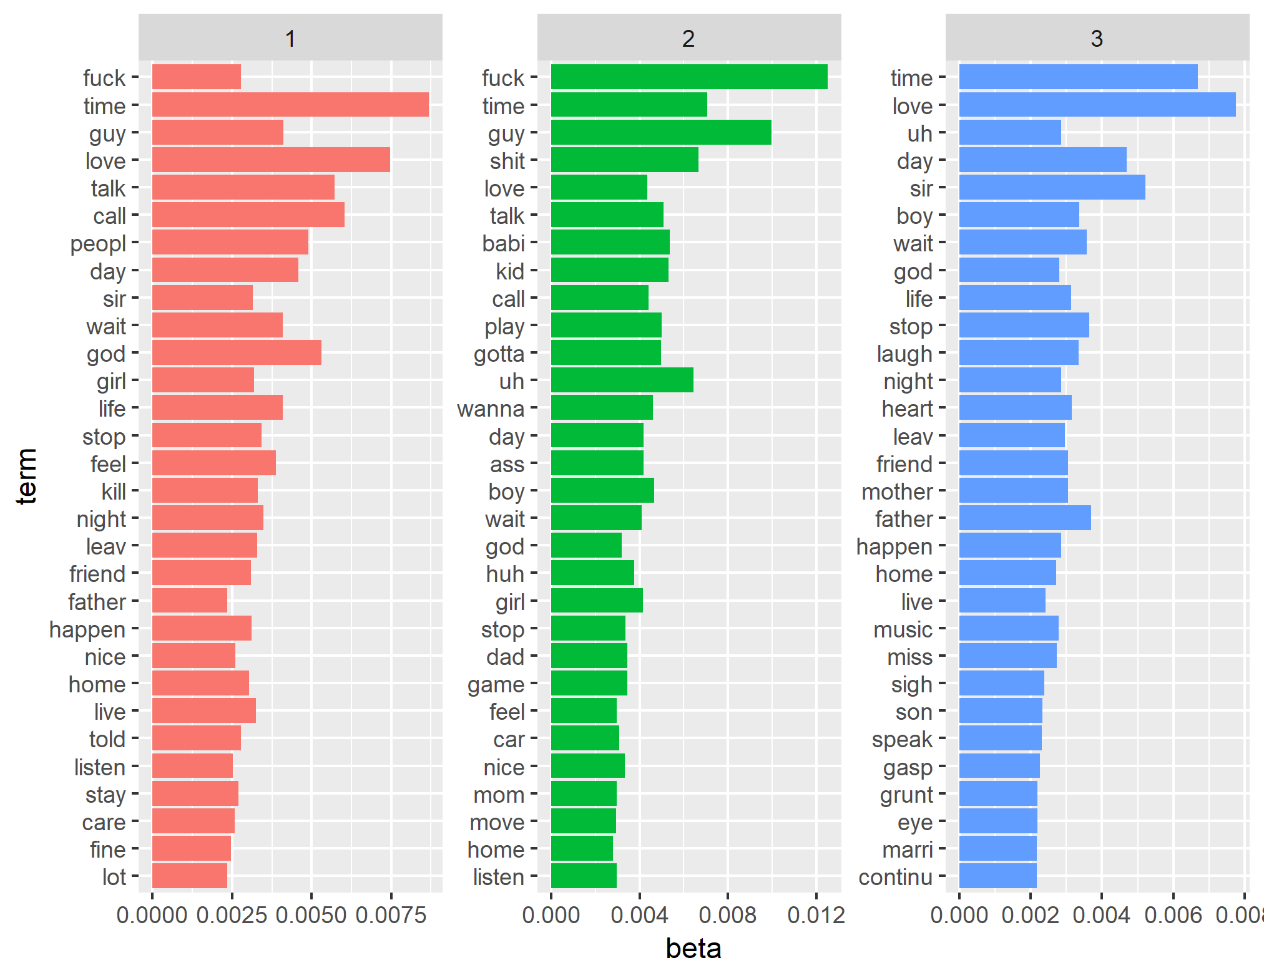
Topic modeling (clusters of referred Paper)
3. Exploratory Analysis - Topic modeling(6\11)

Slide 13
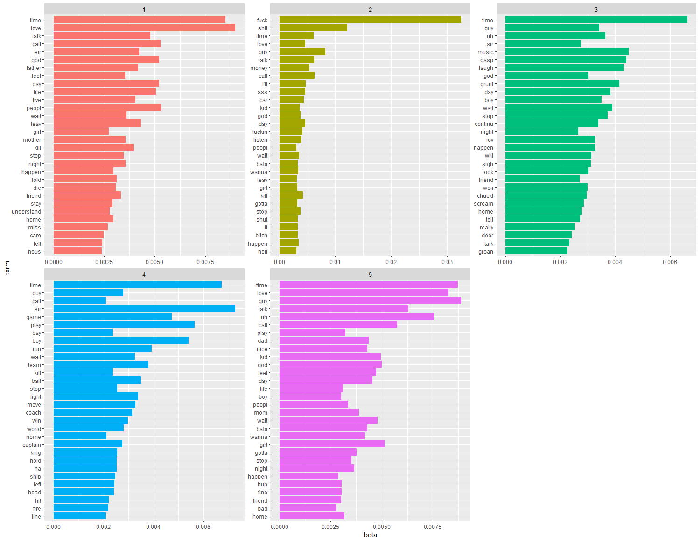
3. Exploratory Analysis - Topic modeling(7\11)

Slide 14
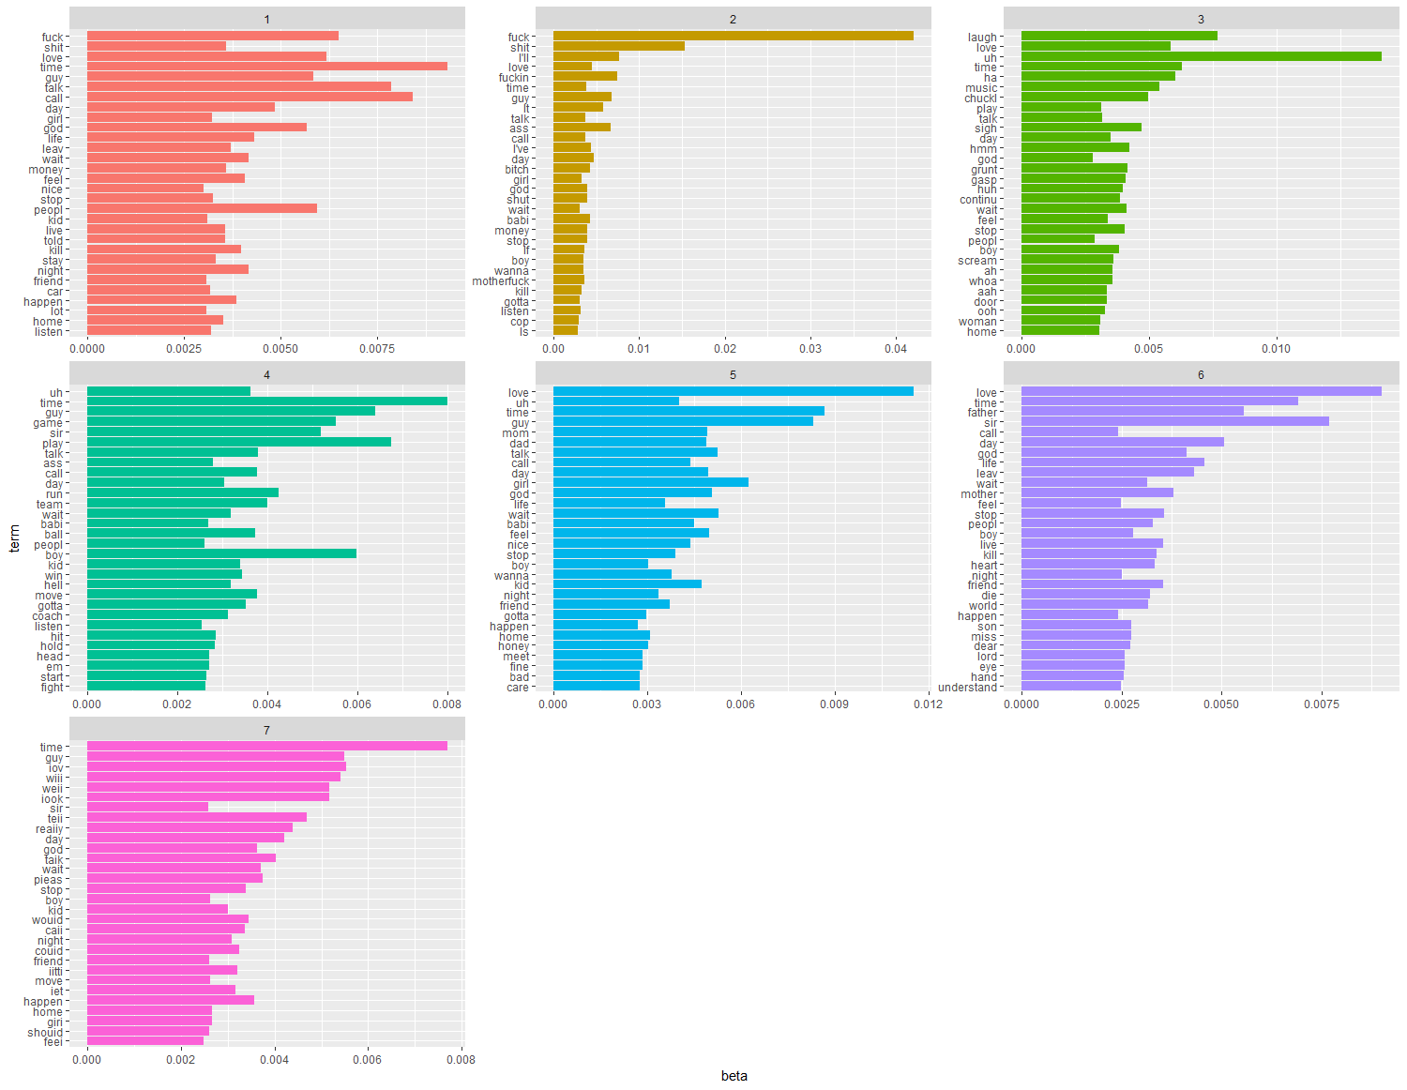
3. Exploratory Analysis - Topic modeling(8\11)

Slide 15
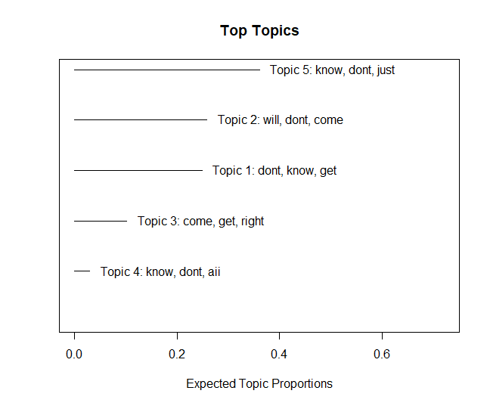
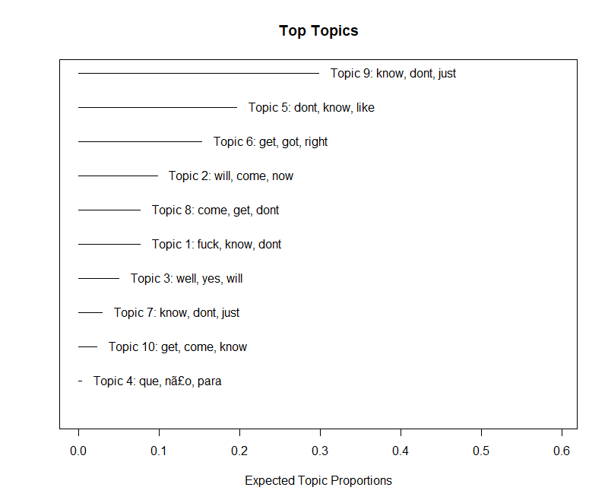
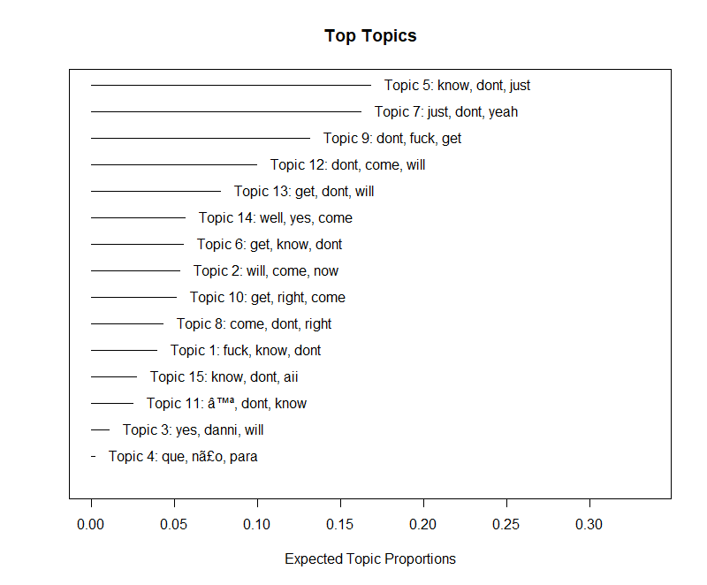
Structural Topic Modeling
3. Exploratory Analysis - Topic modeling(9\11)

Slide 16
K-Means for genre using dialogues
3. Exploratory Analysis - Topic modeling(10\11)
Precision Recall F1-score Support
DCRFSM 0.93 0.02 0.03 823
SAFA 0.14 0.99 0.25 169
CMT 0.00 0.00 0.00 200
avg / total 0.66 0.15 0.06 1192

Slide 17
Intro & Data collection
Exploratory Analysis
1) Topic modeling
2) Network Analysis
3. Sentiment Analysis
4. Clustering & Regression on sentiment
5. Conclusion

Slide 18
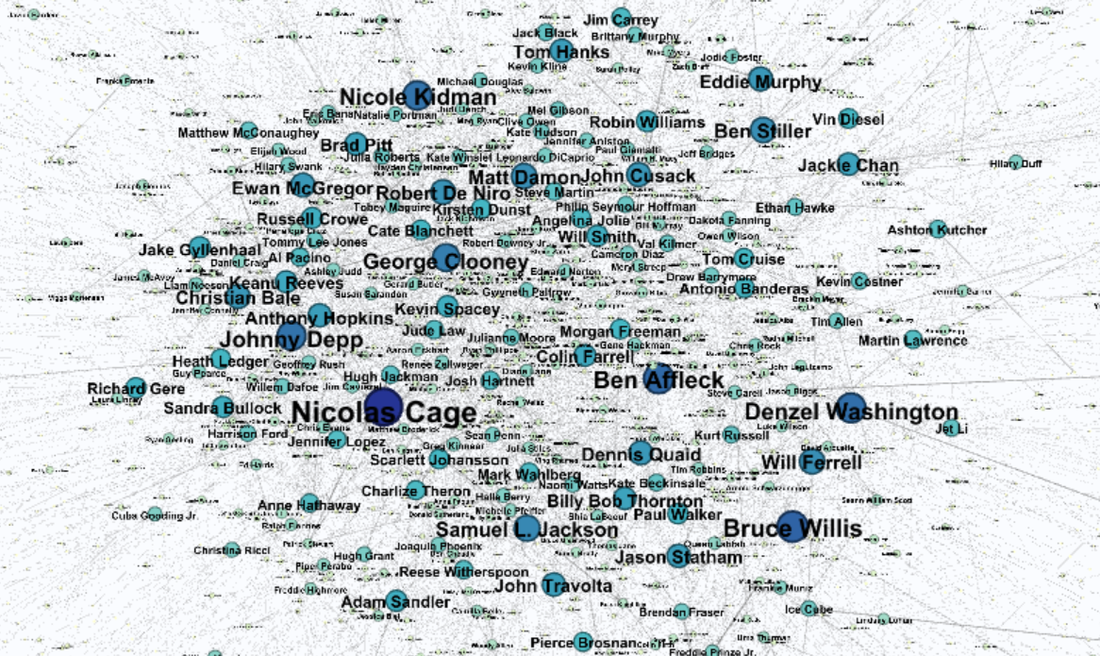
2. Exploratory Analysis - Network Analysis(2\5)
Text network analysis across actors/actresses

Slide 19
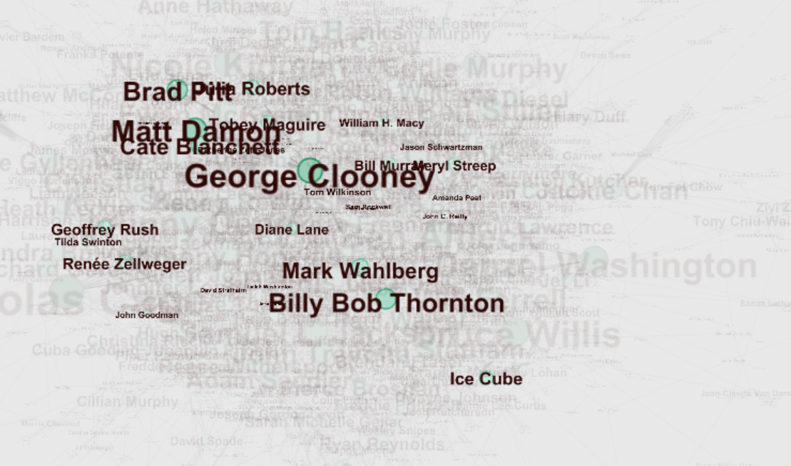



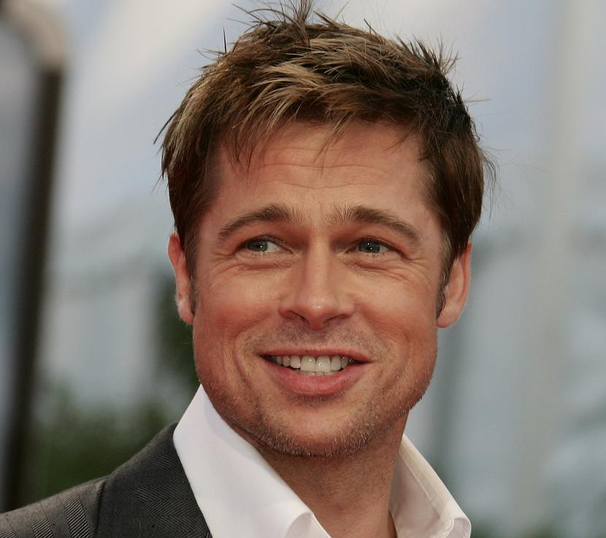
2. Exploratory Analysis - Network Analysis(2\5)
Network analysis across Actors/Actresses
Ex. George Clooney

Slide 20
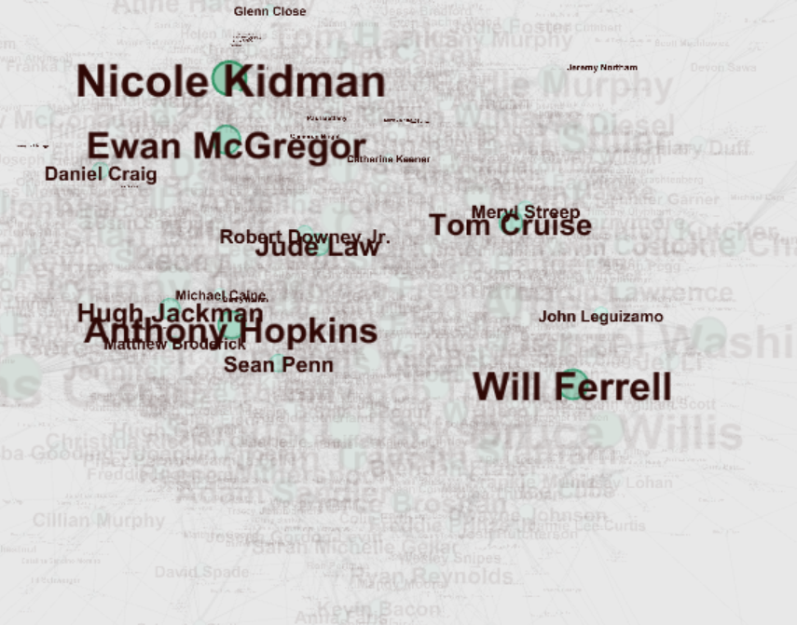
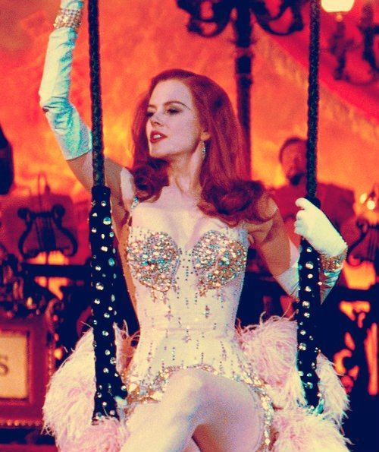
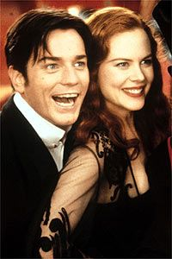


2. Exploratory Analysis - Network Analysis(2\5)
Network analysis across Actors/Actresses
Ex. Nicole Kidman

Slide 21
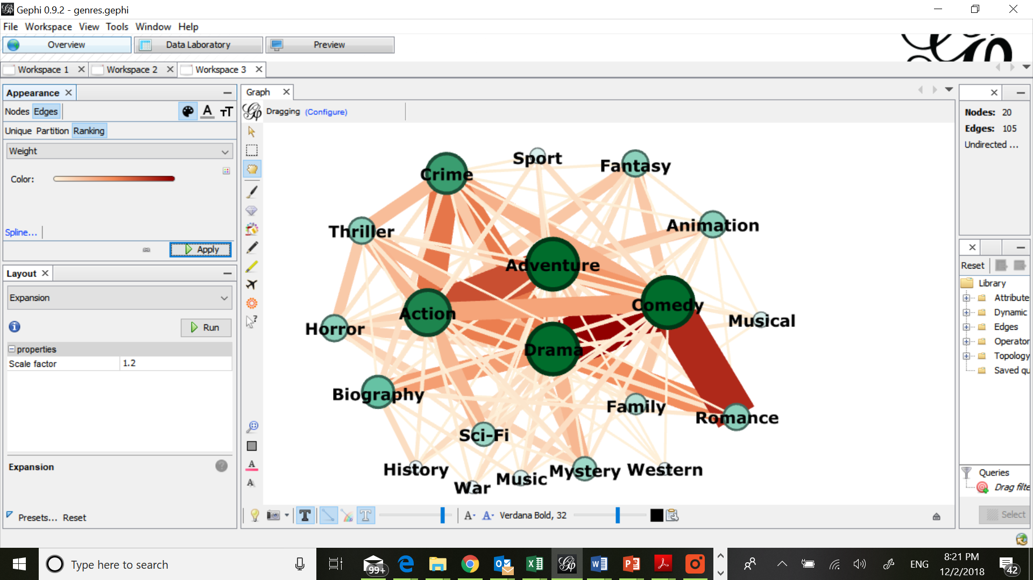
2. Exploratory Analysis - Network Analysis(2\5)
Text network analysis across movie genres
Based on the fact that one movie has max 3 genres
<Example of our data set>
 | Genre 1 | Genre 2 | Genre 3
Movie 1 | Drama | Comedy | Romance
Movie 2 | Action | Adventure | N/A

Slide 22
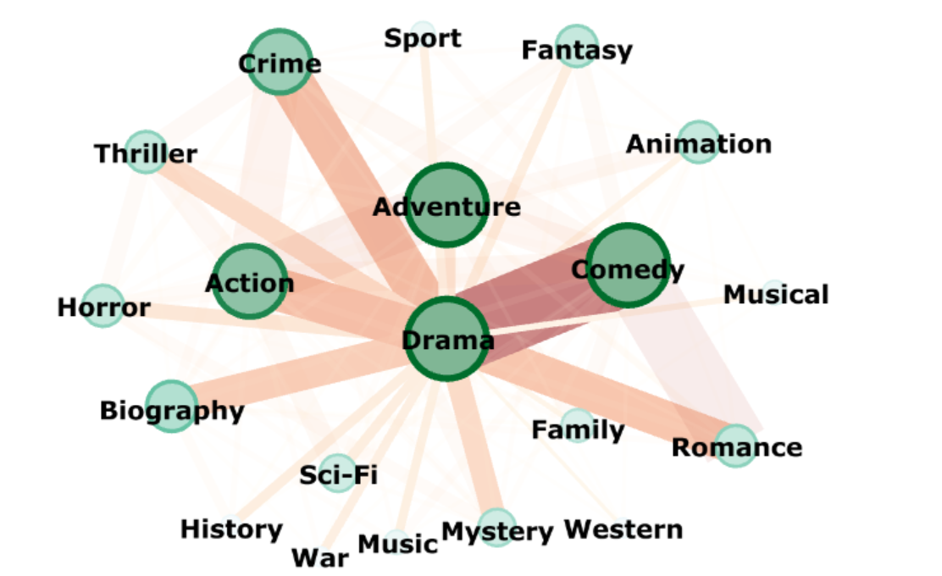
2. Exploratory Analysis - Network Analysis(2\5)
“Drama” had the most overlaps with many genres

Slide 23
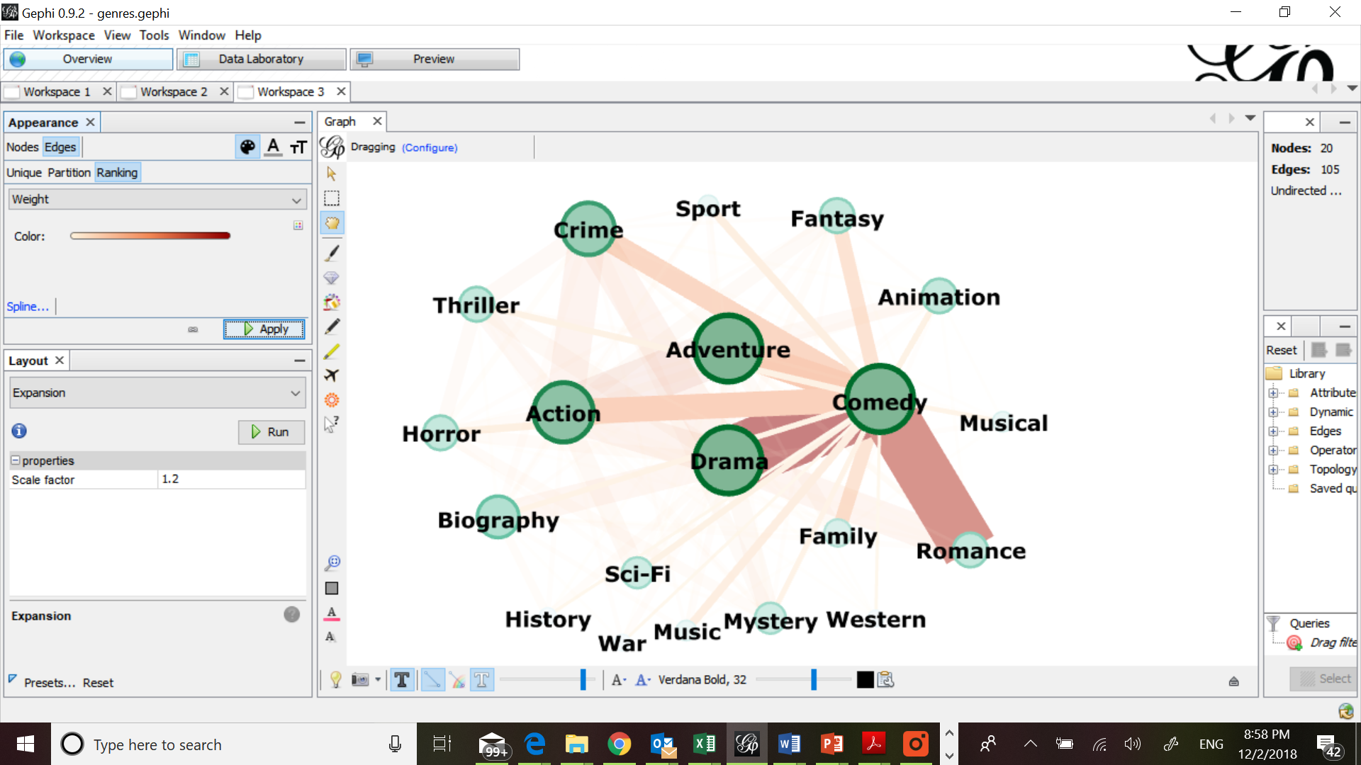
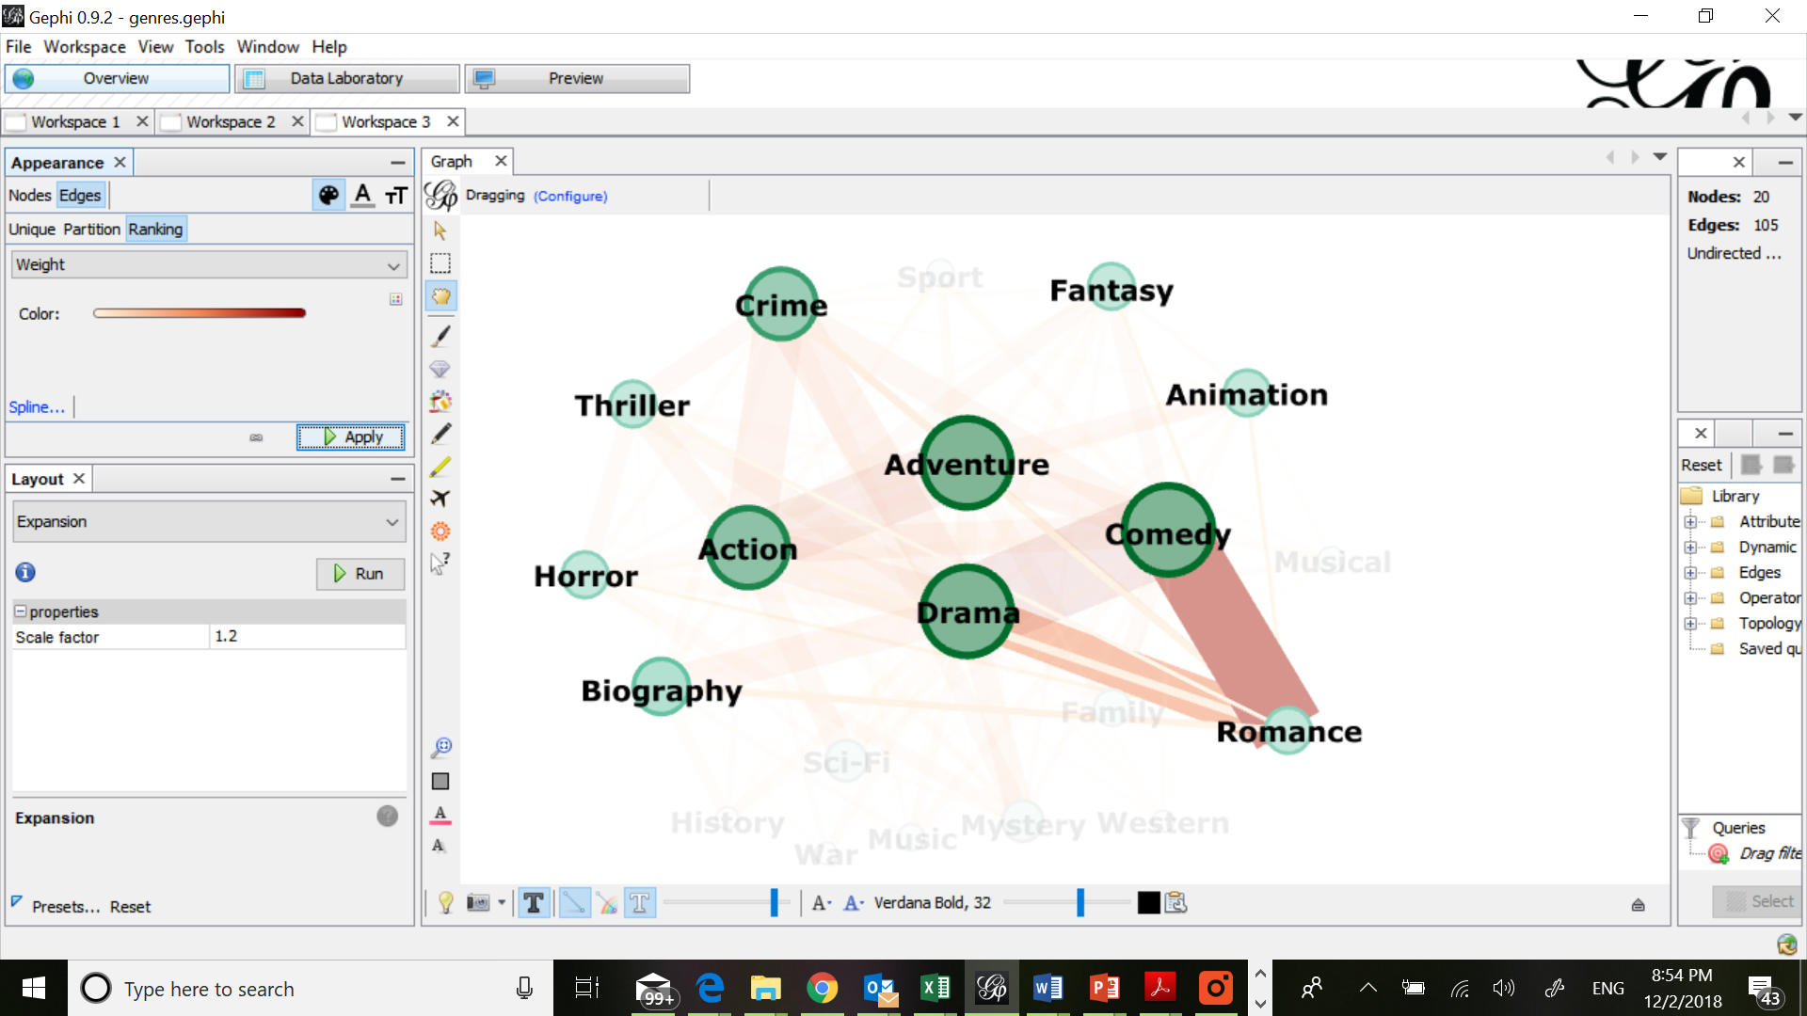
Romance, Comedy & Drama showed strong relationships
2. Exploratory Analysis - Network Analysis(2\5)

Slide 24
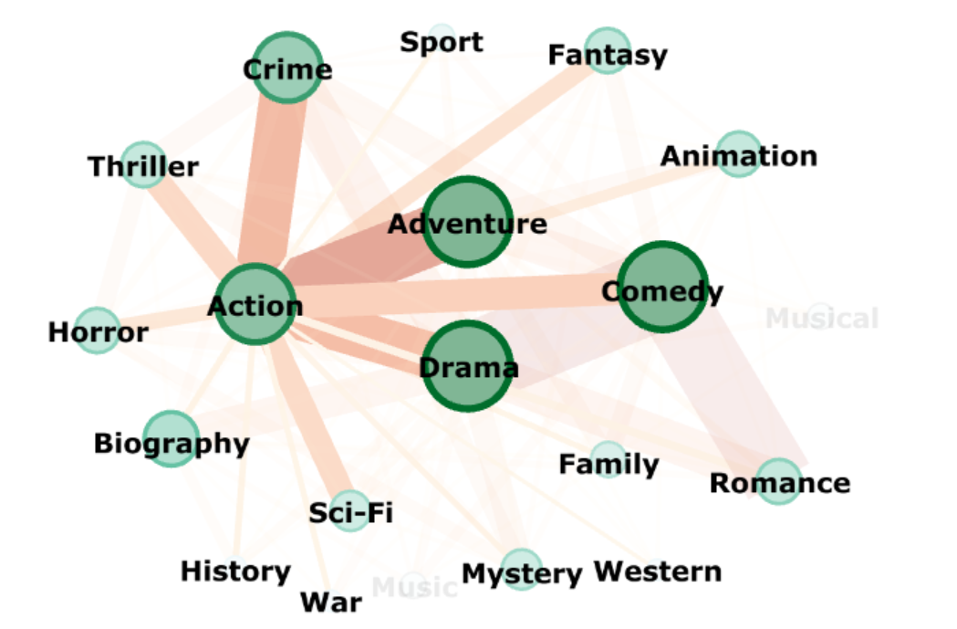
Action : Adventure + Crime
2. Exploratory Analysis - Network Analysis(2\5)

Slide 25
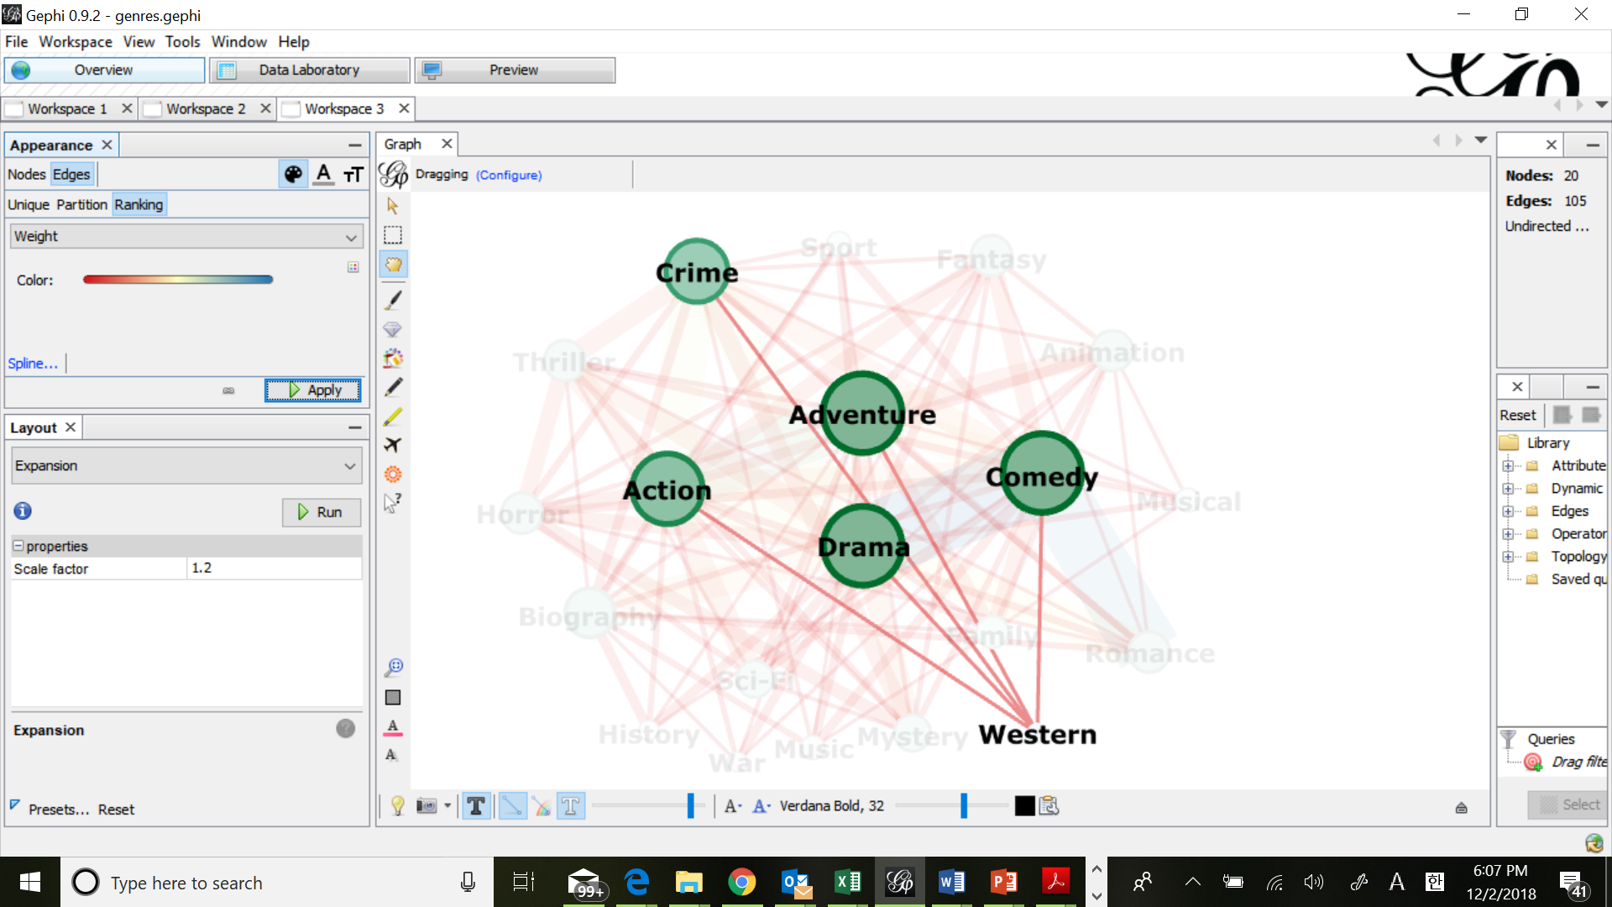

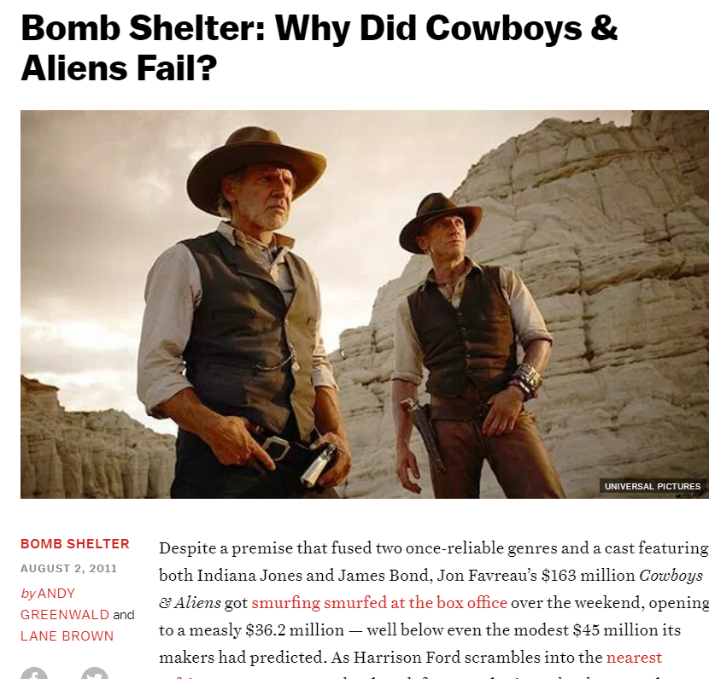
Genres with low relationships are also captured in this analysis
2. Exploratory Analysis - Network Analysis(2\5)
Sci-Fi
Very low relationship between Western and Sci-Fi

Slide 26
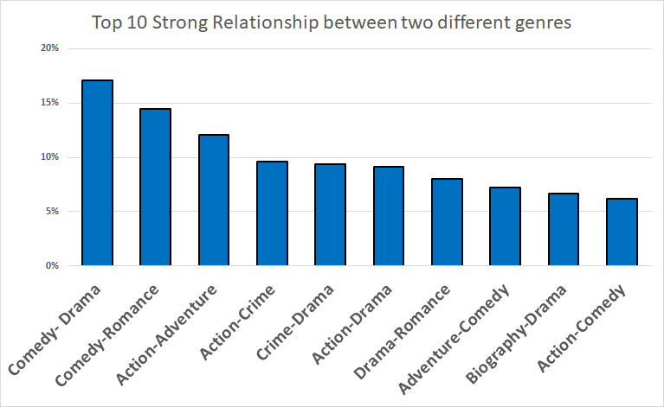
Two main categories “Comedy-Drama-Romance” and “Action-Adventure-Crime” were captured by network analysis
2. Exploratory Analysis - Network Analysis(2\5)

Slide 27
Intro & Data collection
Exploratory Analysis
1) Topic modeling
2) Network Analysis
3. Sentiment Analysis
4. Clustering & Regression based on sentiment
5. Conclusion

Slide 28
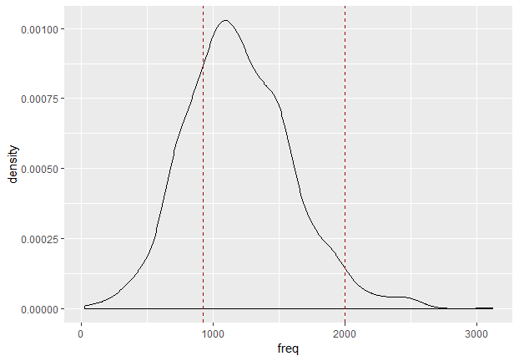
3. Sentiment Analysis(3\5)
Sentiment Vectors
Calculation of sentiment vector
Decide line number range(925-2000)

Slide 29
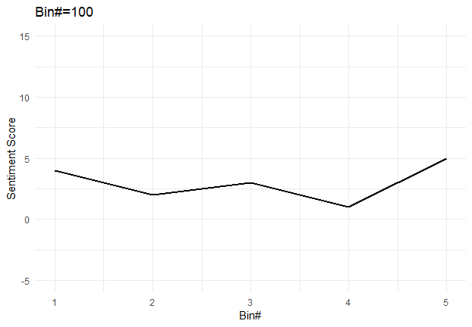
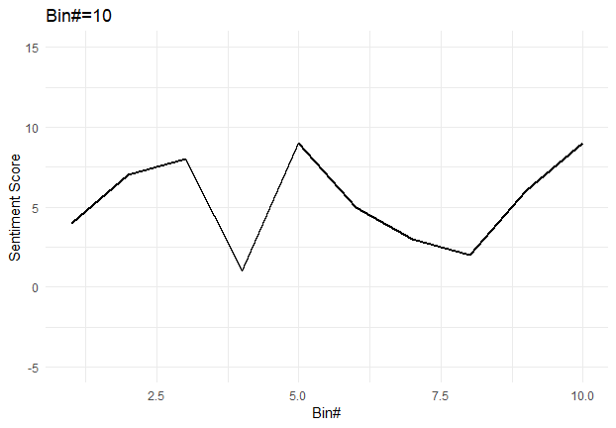
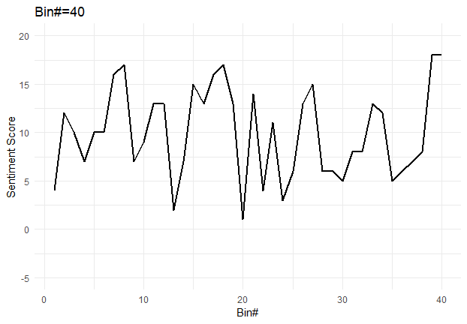
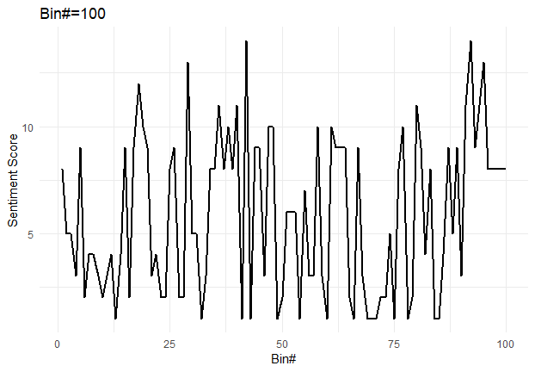
3. Sentiment Analysis(3\5)
Sentiment Vectors
Decide bin number(40)

Slide 30
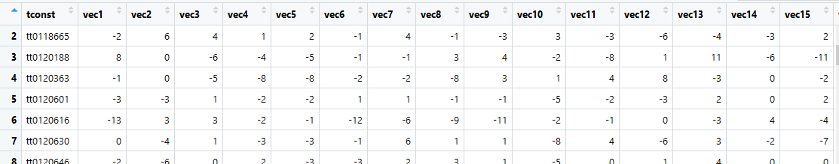
3. Sentiment Analysis(3\5)
Sentiment Vectors
For each bin:
Remove stop words
Join dictionary ‘bing’
Calculate (positive word number - negative word number)
1311 movies

Slide 31
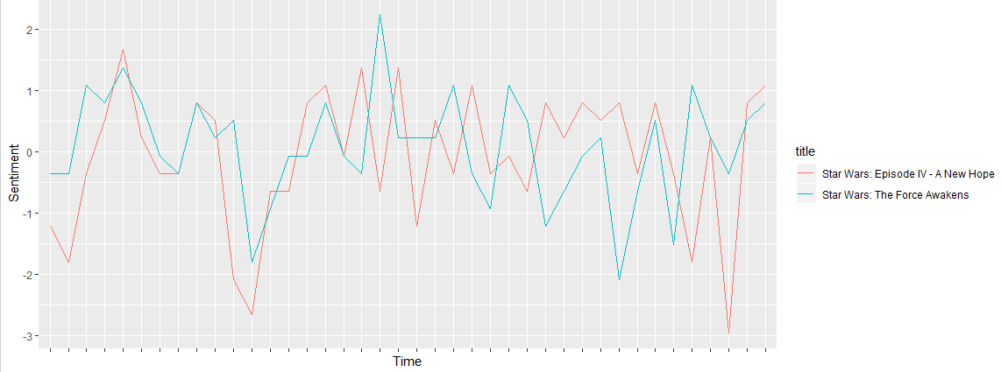
3. Sentiment Analysis(3\5)
Sentiment Vectors

Slide 32
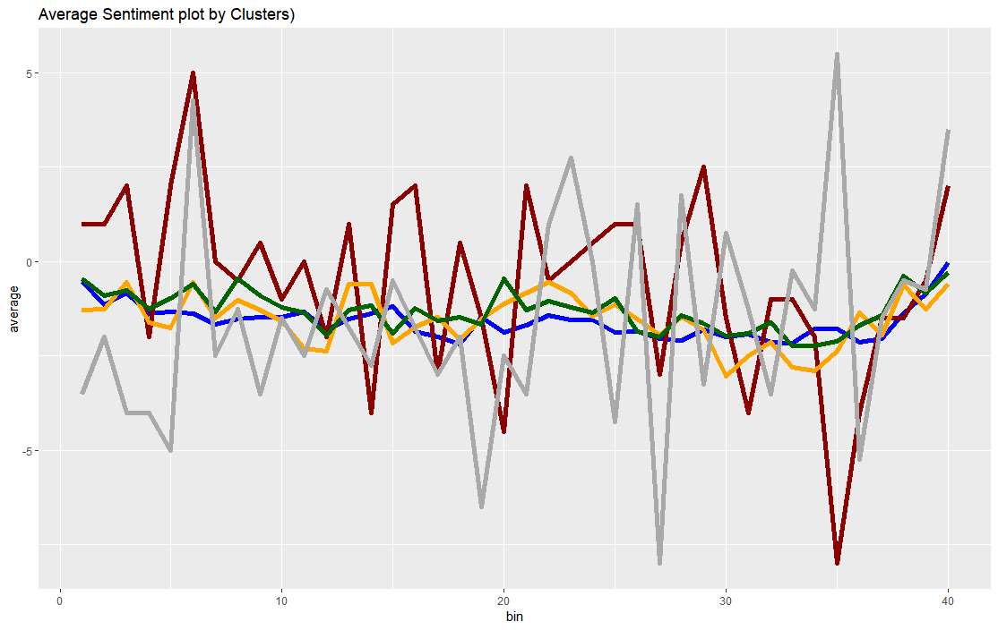
Overall, different sentiment volatility across genres, mostly landed below zero, suggesting more negative word usage according to the analysis with dictionary ‘Bing’
3. Sentiment Analysis(3\5)
< Sentiment plot >
Set-up Development Turn Conclusion
Drama,Comedy
Action
Adventure
Crime, Thriller
Horror
Y axis : sentiment vectors, X axis : running time(bins)

Slide 33
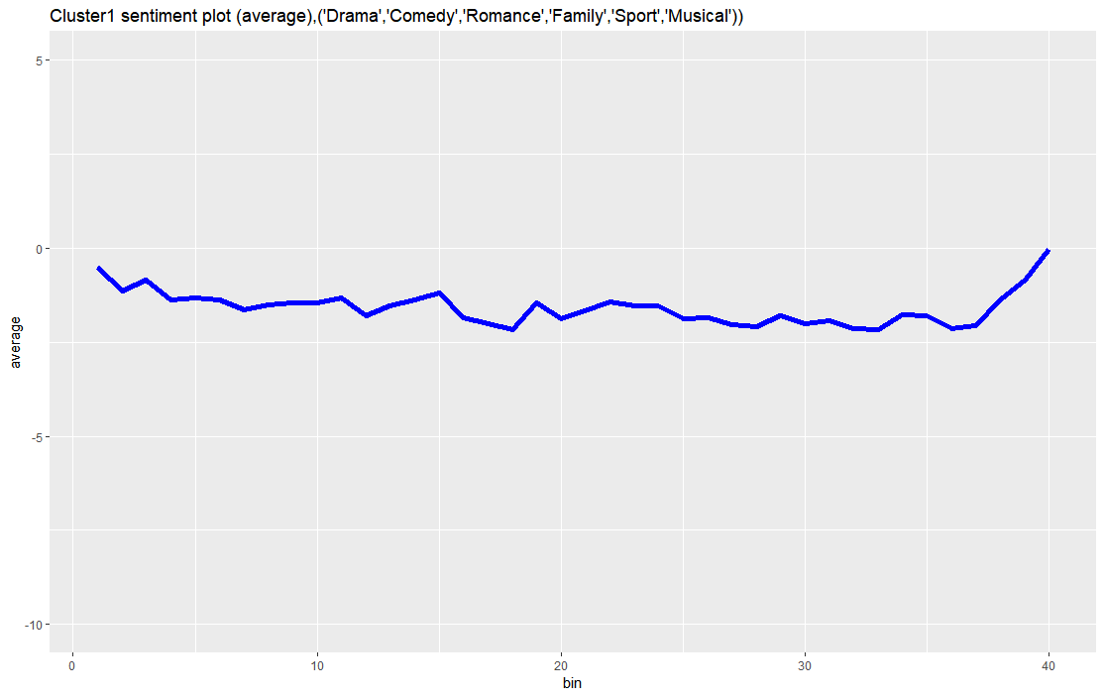
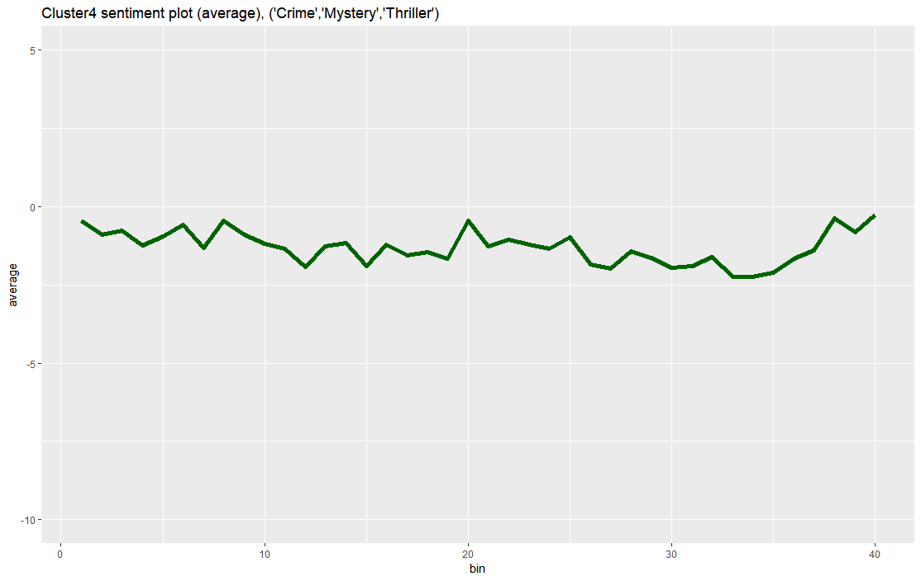
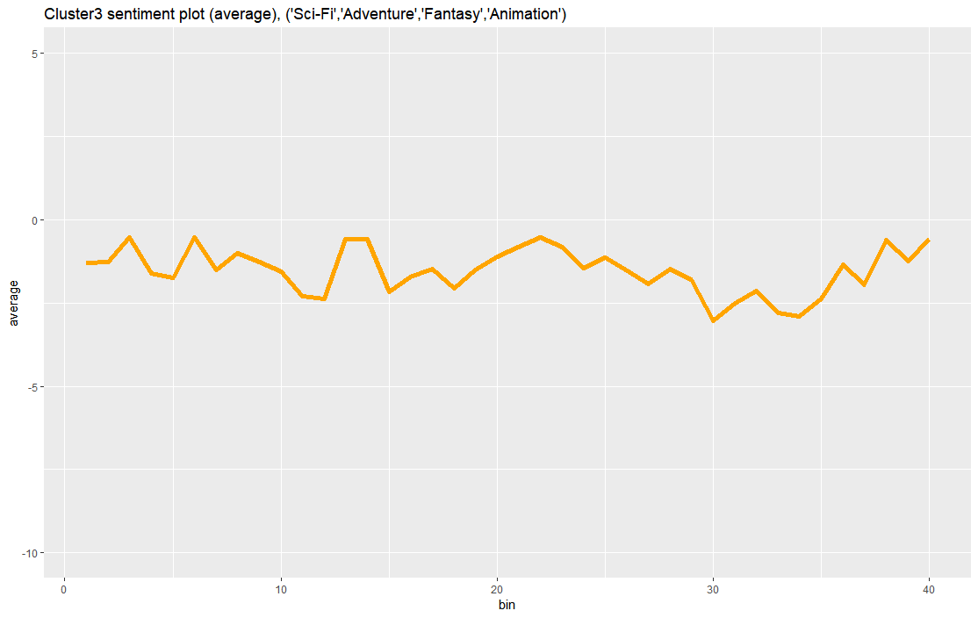
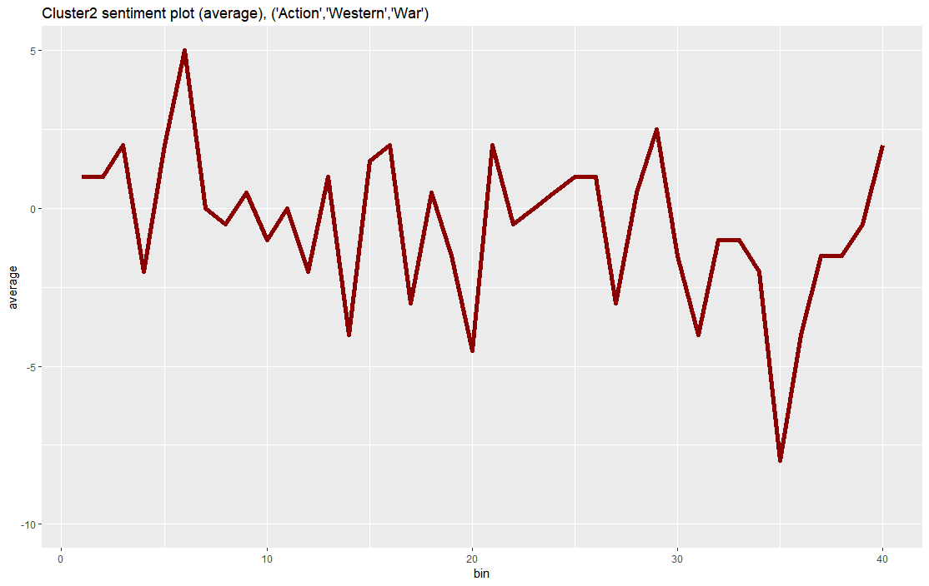
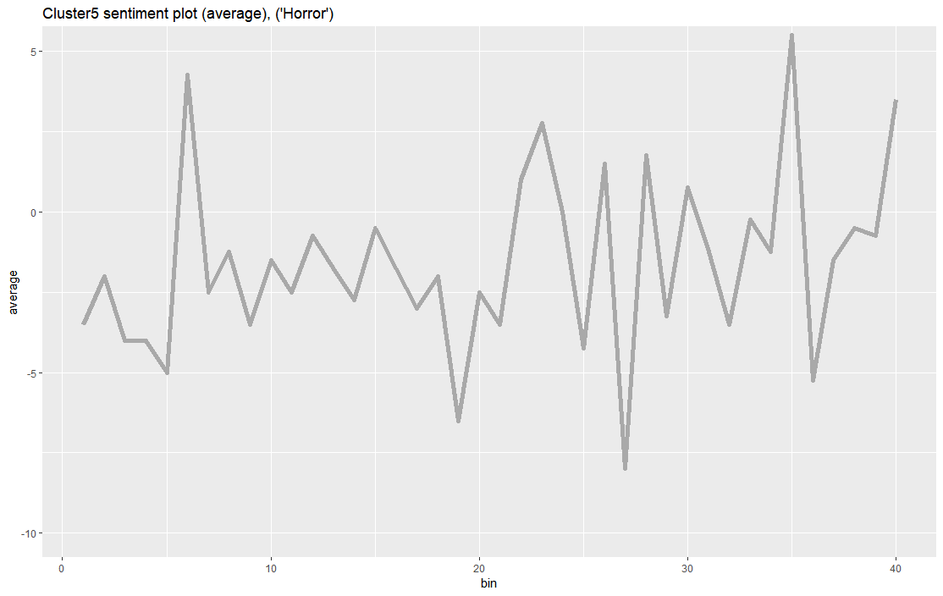
Genres can be categorized into two main groups, “Emotional Connection” and “High Stimulation”
3. Sentiment Analysis(3\5)
1
[Group 1]
“Emotional Connection”
5
0
-5
-10
5
0
-5
-10
5
0
-5
-10
Adventure
Less volatile sentiment shifts
Drama/Comedy
Thriller
2
[Group 2]
“High Stimulation”
5
0
-5
-10
5
0
-5
-10
Higher volatility in sentiment
Action Horror
X axis: Running time, Y axis: Sentiment vectors

Slide 34
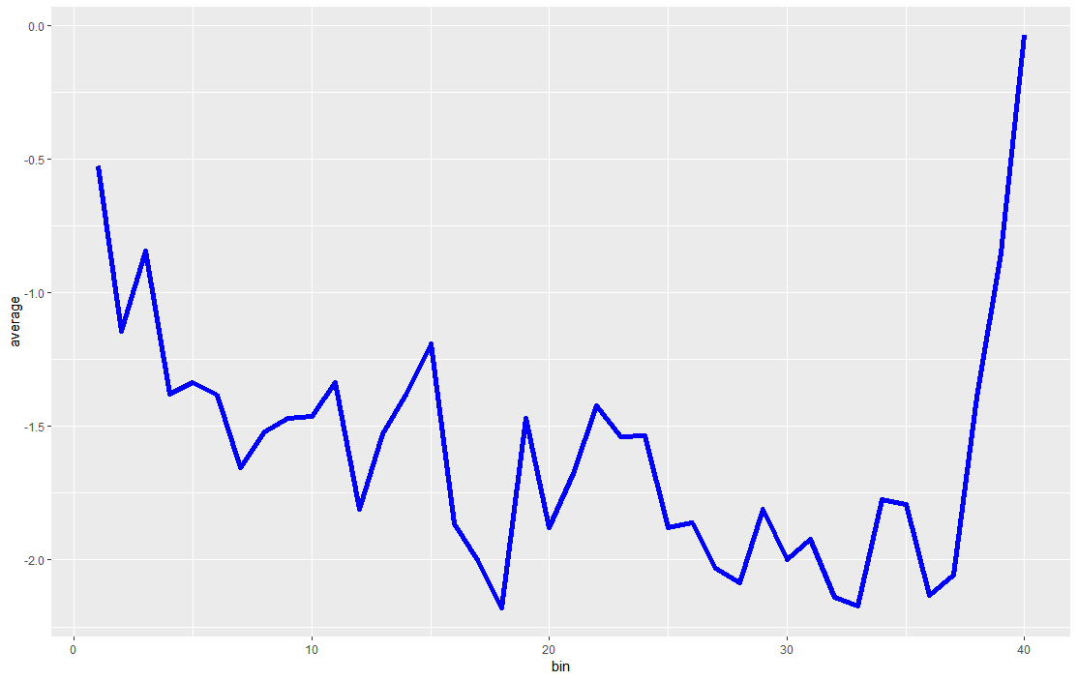
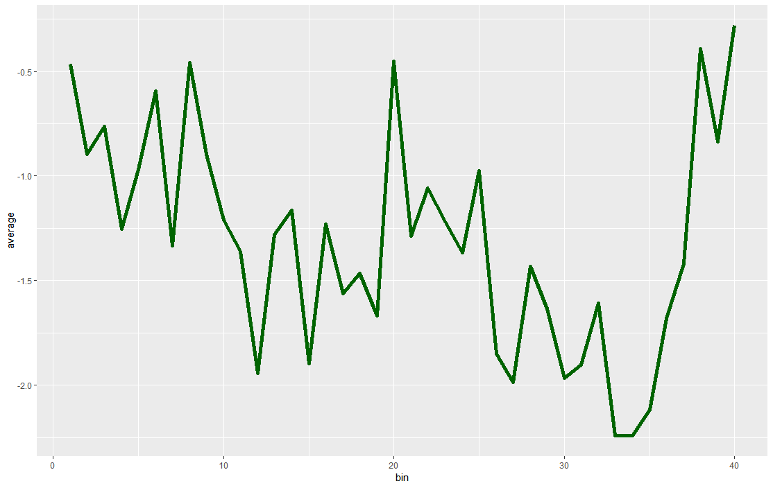
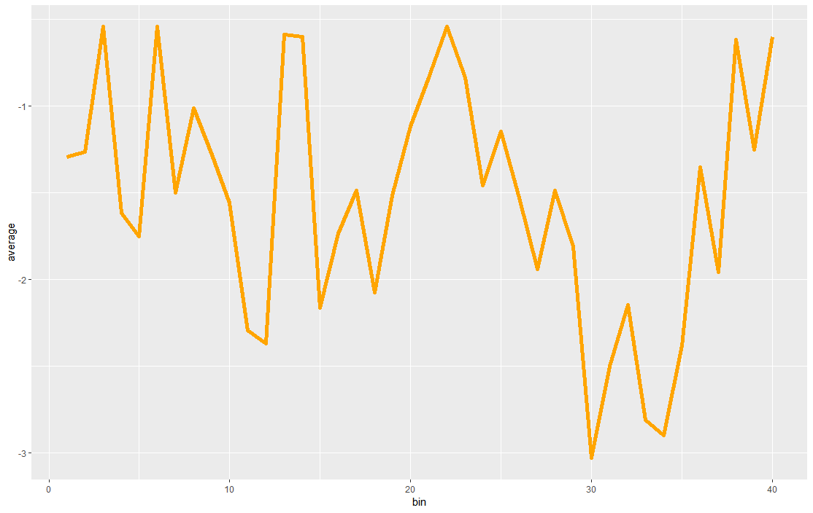
Genres in Group 1 display similar sentiment usage throughout storyline
3. Sentiment Analysis(3\5)
1
[Group 1] “Emotional Connection”
Set-up Development Turn Conclusion
Drama/
Comedy
Thriller
Adventure

Slide 35
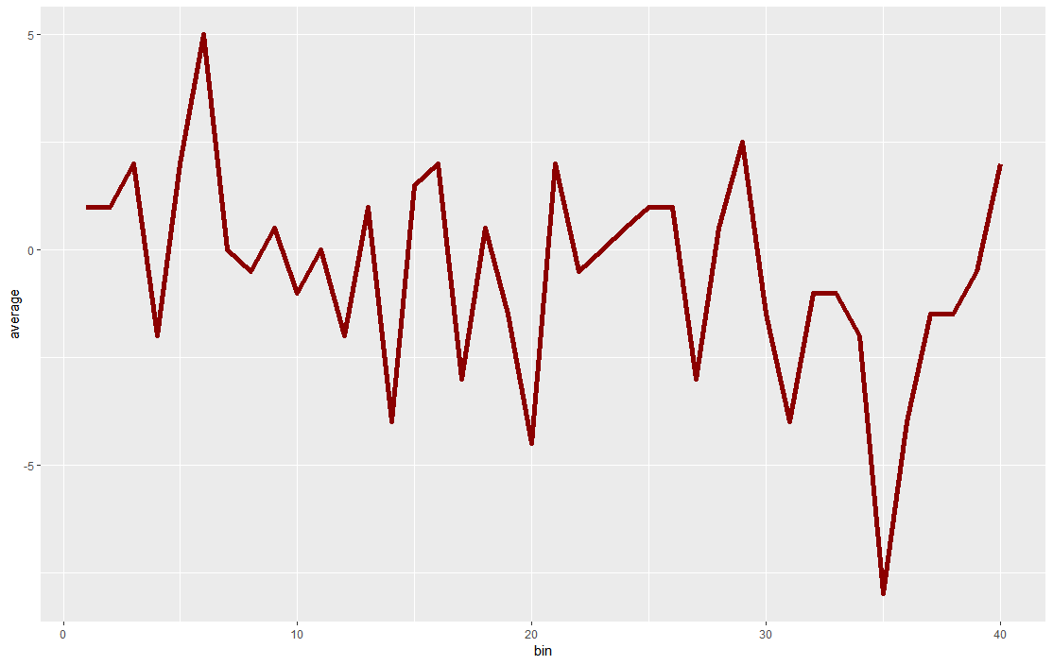
Generally, Genres in Group 2 use sharper and extreme sentiments, but with quite different direction of sentiment in their storytelling
3. Sentiment Analysis(3\5)
2
[Group 2] “High Stimulation”
Set-up Development Turn Conclusion
Action
Horror

Slide 36
Intro & Data collection
Exploratory Analysis
1) Topic modeling
2) Network Analysis
3. Sentiment Analysis
4. Clustering & Regression based on sentiment
5. Conclusion

Slide 37
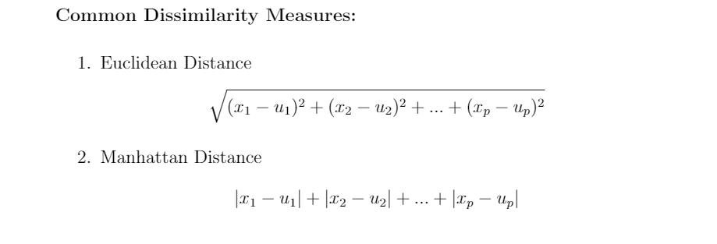




Distance Metrics
4. Clustering & Regression based on Sentiment(4\5)

Slide 38



K-means clustering
4. Clustering & Regression based on Sentiment (4\5)
Stage1： Using 40 Sentiment Vectors Directly as Predictor Variables
Stage2： Using PCA to exclude dependency among predictor variables

Slide 39


Hierarchical clustering (Dendrogram) with k=5
4. Clustering & Regression based on Sentiment (4\5)
Only Using Euclidean distance between each movie’s sentiment vectors , we grouped movies into 5 different clusters without knowing its real genre
Movies

Slide 40


Five main hierarchical clusters were identified, ranging from very positive words to profanity grouping
4. Clustering & Regression based on Sentiment (4\5)
< Word cloud >
< Sentiment plot >
2
Positive sentiment
3
1
4
2
3
1
5
5
Negative sentiment
4

Slide 41

There were different composition of genres across hierarchical clusters The more ‘crime, mystery, thriller’ movie a cluster has, the more negative its sentiment becomes
4. Clustering & Regression based on Sentiment (4\5)
< Word cloud >
< Comparison between
Hierarchical clustering & Real genres>
2
Positive sentiment
3
1
4
2
3
1
5
5
Negative sentiment
4

Slide 42


DTW Clustering --Hierarchical with k = 10
4. Clustering & Regression based on Sentiment (4\5)

Slide 43


4. Clustering & Regression based on Sentiment (4\5)
Prediction for box office & ratings
Centroid of a cluster represents the character of sentiment fluctuations in each genre
Typical: close to the centroid
Novel: distant from the centroid
Distance metrics: dynamic time warping

Slide 44




Prediction for box office & ratings
4. Clustering & Regression based on Sentiment (4\5)
Linear regression model (box office)
Similar results with ratings model
Conclusion: movies with more unique sentiment fluctuations would likely to contribute to higher box office and ratings

Slide 45

K-Means with a Narrower Scope
4. Clustering & classification based on Sentiment (4\5)
~100 titles from 3 distinct genres:
Horror
Romantic Comedy
Animated Children’s

Slide 46

K-Means with a Narrower Scope
4. Clustering & classification based on Sentiment (4\5)

Slide 47
Intro & Data collection
Exploratory Analysis
1) Topic modeling
2) Network Analysis
3. Sentiment Analysis
4. Clustering & Classification based on sentiment
5. Conclusion

Slide 48
Limitations
5. Conclusion (5\5)
API Issues
Sentiment vs. Meaning
Selection Bias
Dictionary used

Slide 49
Intro & Data collection
Exploratory Analysis
1) Topic modeling
2) Network Analysis
3. Sentiment Analysis
4. Clustering & Classification based on sentiment
5. Conclusion

Slide 50
Future business applications
5. Conclusion (5\5)
Recommendation System
-According to customers’ general sentiment level within the genre(how positive or how negative the movie's sentiment is)
-Volatility of the movie's sentiment change (how dramatic a movie is)
-Key word/topic
When customers choose movies to watch, if they can select its general sentiment level or key word..isn't it cool?

Slide 51
Future Analysis
5. Conclusion(5/5)
Possible metrics to apply:
Latent semantic analysis (LSA) to measure if two movies share similar meanings. Measure the semantic coherence of dialogues or “abruptness”.
Parts of Speech tagging(POS-tag) to measure syntactic features of movies. Measure “Complexity” and “Concreteness” of dialogues.
Sentiment Volatility measure surprise and emotional impact of the plot.

Slide 52
Thank you

Slide 53
EXTRA MATERIAL

Slide 54


Zipf’s Law
3. Exploratory Analysis - Topic modeling(3\10)
Zipf's law states that given some corpus of natural language utterances, the frequency of any word is inversely proportional to its rank in the frequency table.

Slide 55



Top 10 most frequent words

Slide 56


Latent Dirichlet Analysis

Slide 57



Structural Topic Modeling

Slide 58
Kmeans 3 genre new bucket of movies
precision recall f1-score support
Romance 0.05 0.06 0.06 100
Children 0.38 0.69 0.49 96
Horror 1.00 0.01 0.02 97
avg / total 0.47 0.25 0.19 293

Slide 59



3. Sentiment Analysis(3\5)
Block Diagram - the “Bourne” series
Distance matrix
Identifies the sentiment fluctuations of a movie
Actually no stereotype as we thought
The Bourne Identity (02)
The Bourne Supremacy (04)
The Bourne Ultimatum (07)

Slide 60






3. Sentiment Analysis(3\5)
Block Diagram - the ‘Star Wars’ series
Star Wars I (77)
Star Wars II (80)
Star Wars III (83)
Star Wars IV (99)
Star Wars V (02)
Star Wars VI (05)

